Slide 1
Applies Data Structure and Application
Dr Sachin K Saxena Sr Data Analyst, Portugal, MNC
Ex-Sr Software Engineer - Data Scientist

Slide 3
Content
Graphs: Terminologies and Representation
Path Matrix
Graph Traversals - DFS and BFS
Shortest Path Problems
Minimum Cost Spanning Trees
Topological Sort

Slide 4
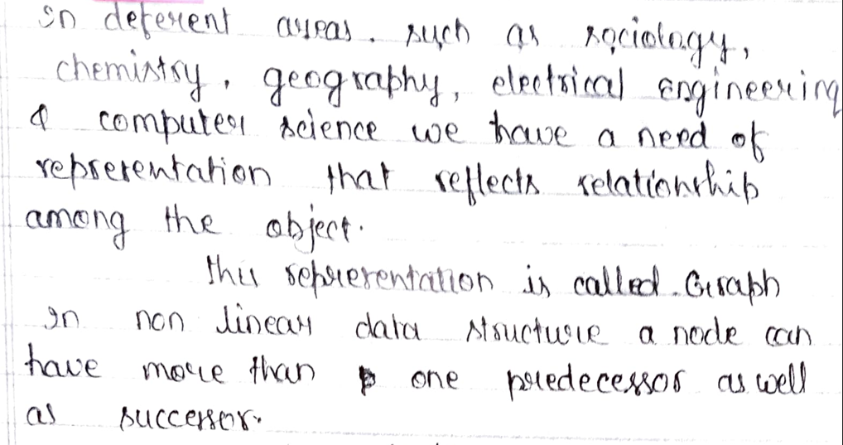
Graphs: Terminologies and Representation

Slide 5
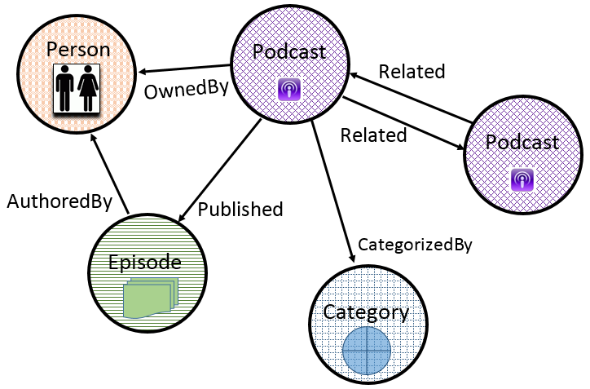
Graphs: Application

Slide 6
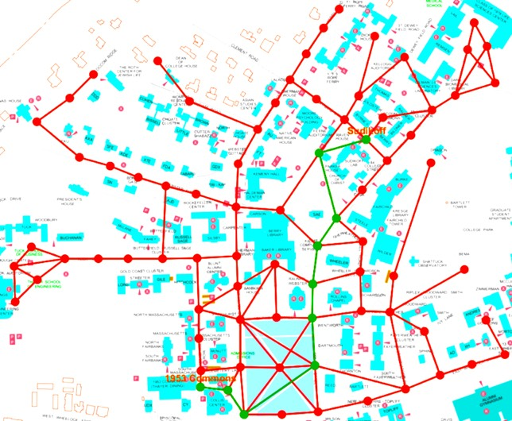
Graphs: Application

Slide 7
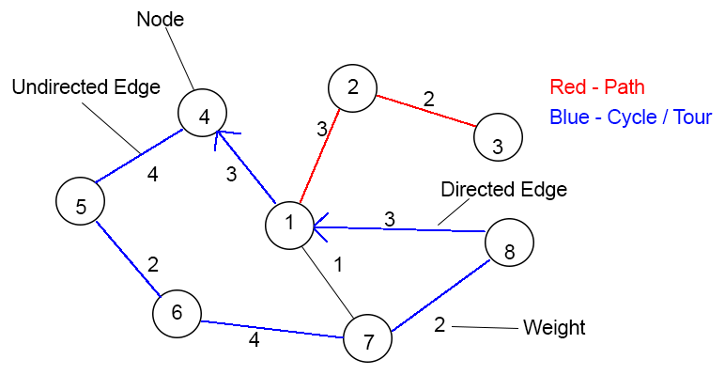
Graphs: Terminologies and Representation

Slide 8
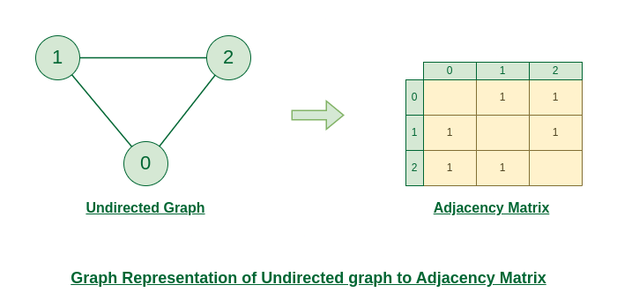
Path Matrix

Slide 9
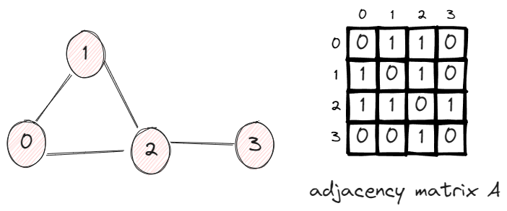
Path Matrix

Slide 10
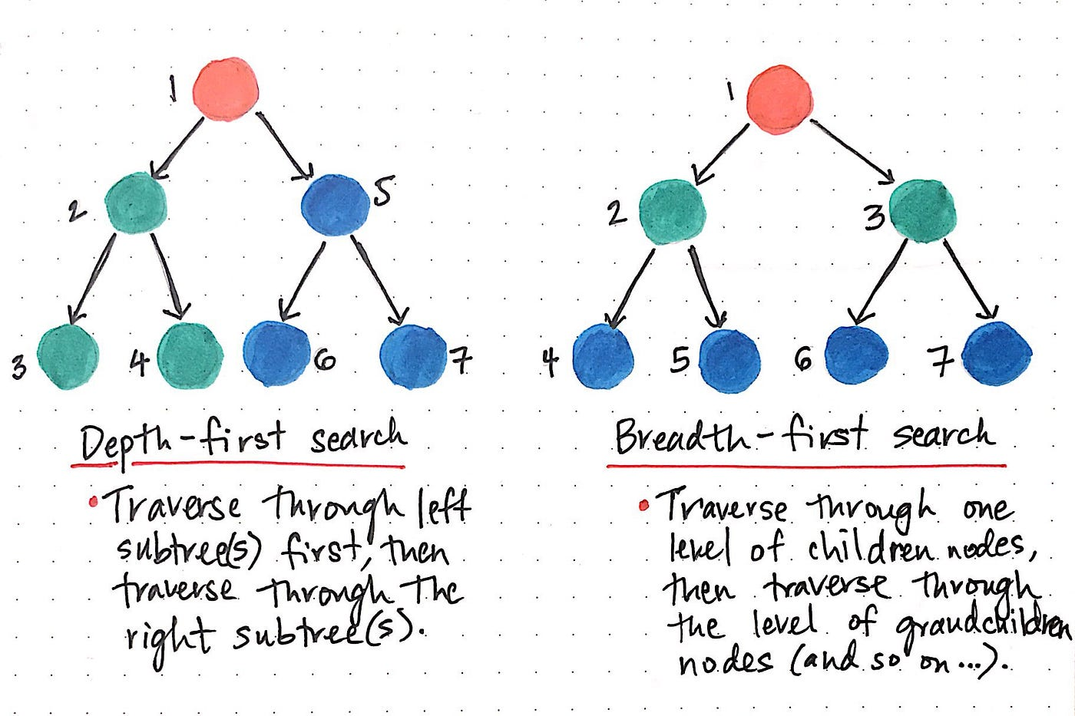
Graph Traversals - DFS and BFS

Slide 11
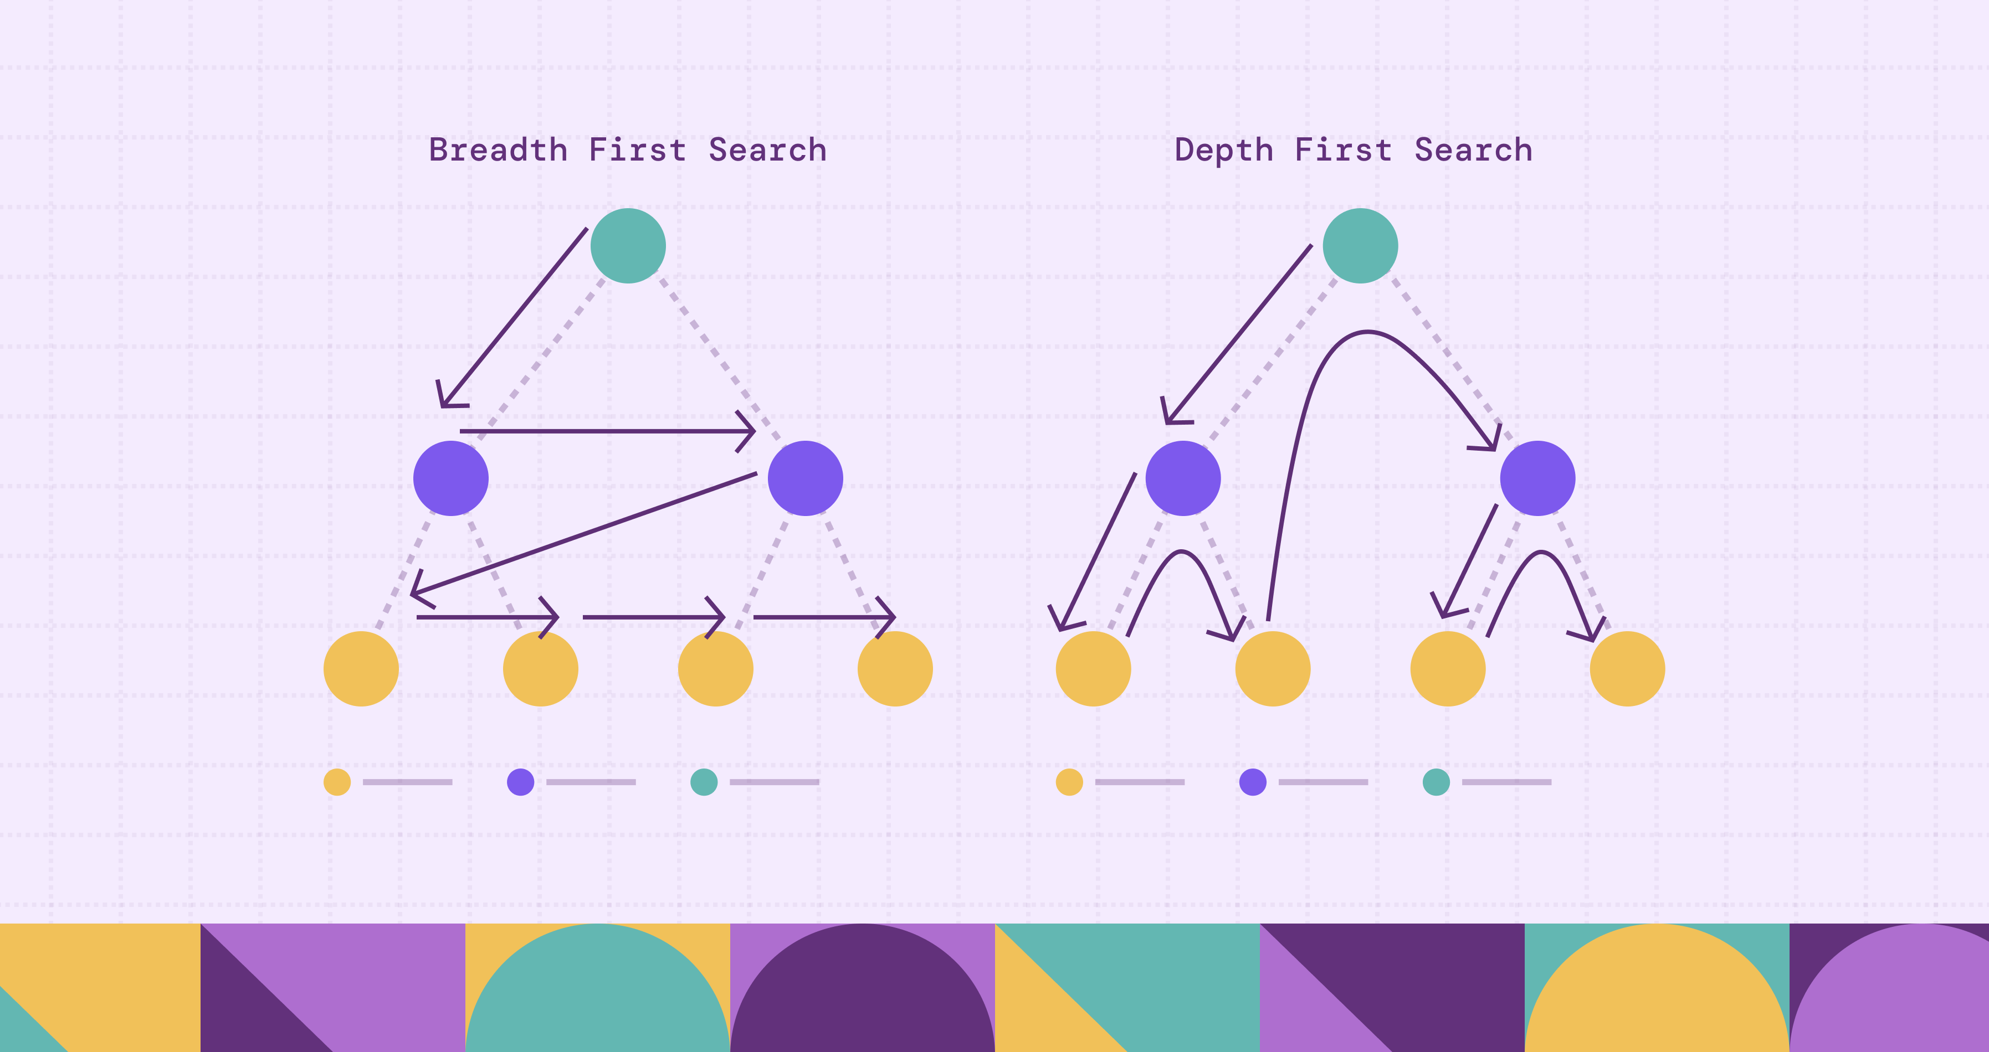
Graph Traversals - DFS and BFS

Slide 12
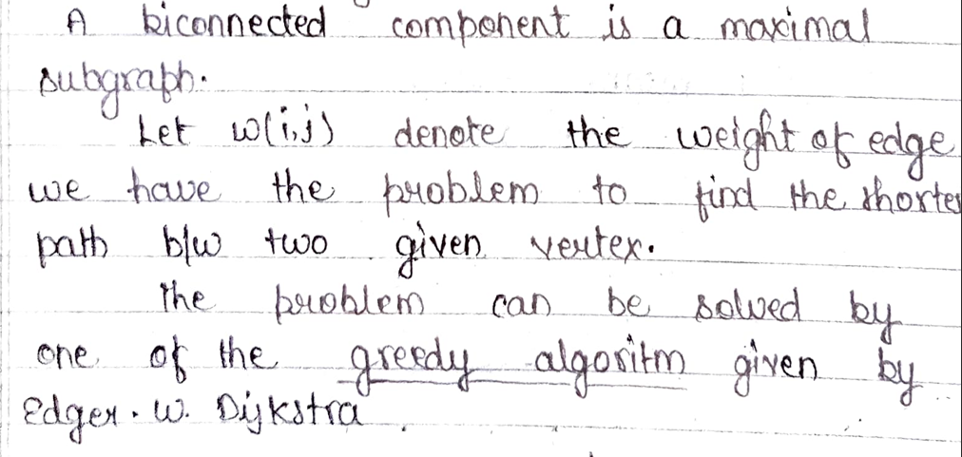
Shortest Path Problems

Slide 13
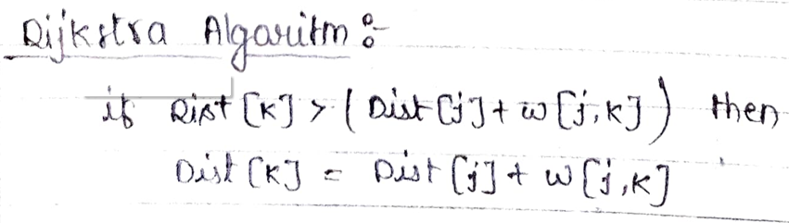
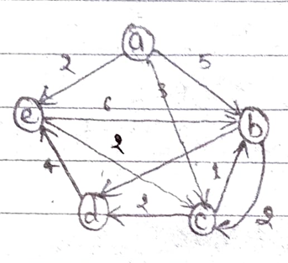
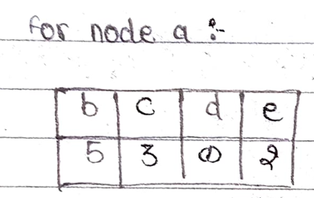
Shortest Path Problems

Slide 14
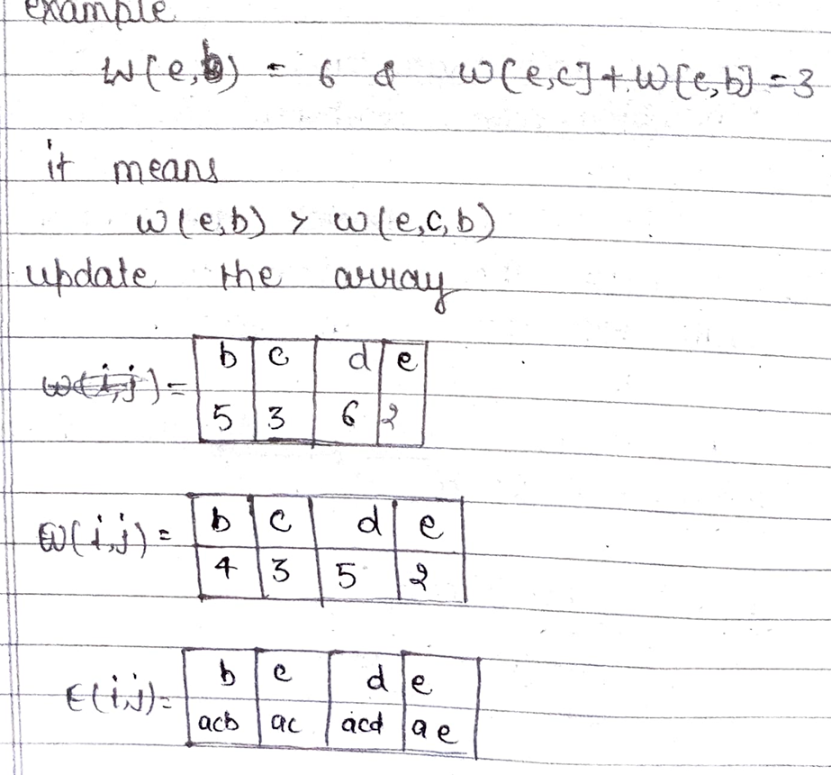
Shortest Path Problems

Slide 15
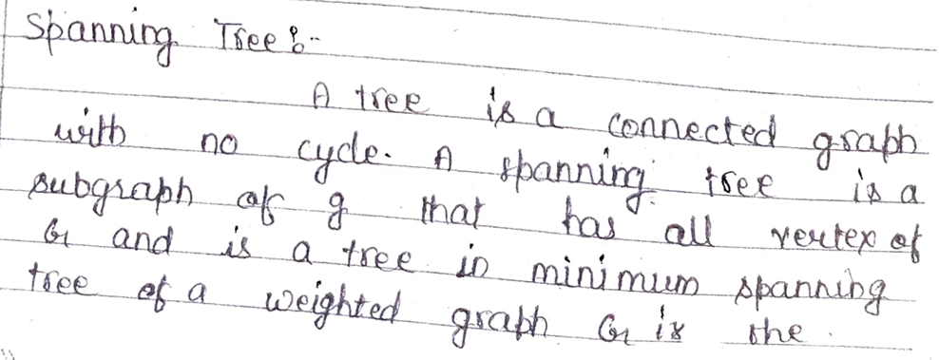
Minimum Cost Spanning Trees

Slide 16
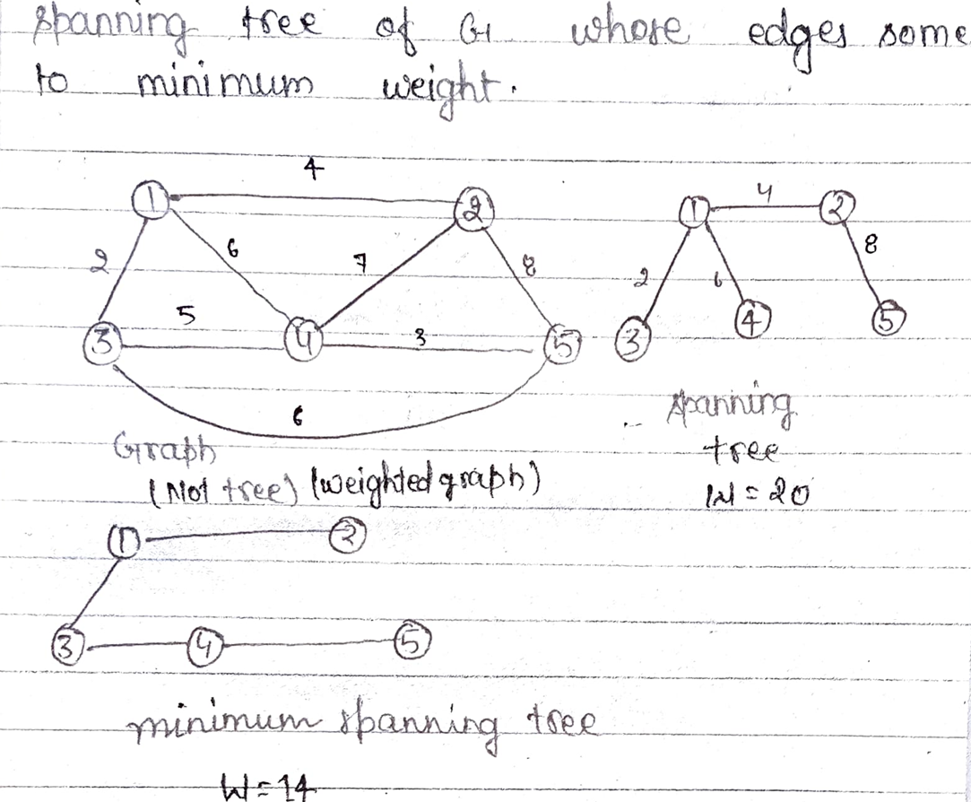
Minimum Cost Spanning Trees

Slide 17
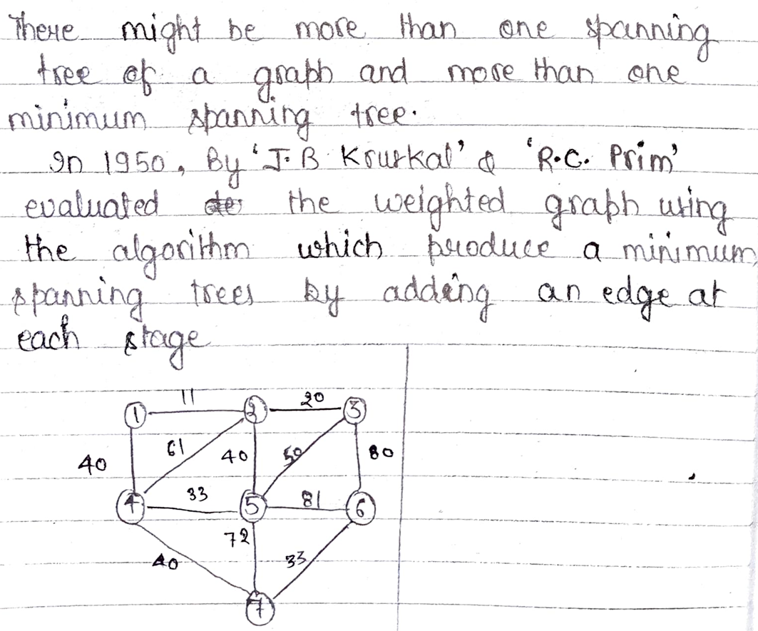
Minimum Cost Spanning Trees

Slide 18
Topological Sort
Topological sorting for Directed Acyclic Graph (DAG) is a linear ordering of vertices such that for every directed edge u→v, vertex u comes before v in the ordering. There may be several topological orderings for a graph.
Applies only to DAGs (Directed Acyclic Graphs), and is not possible for cyclic or undirected graphs.
It represents dependency ordering between vertices which is different from normal DFS or BFS traversals.
Used in problems like task scheduling, build order, course prerequisite ordering, etc.

Slide 19
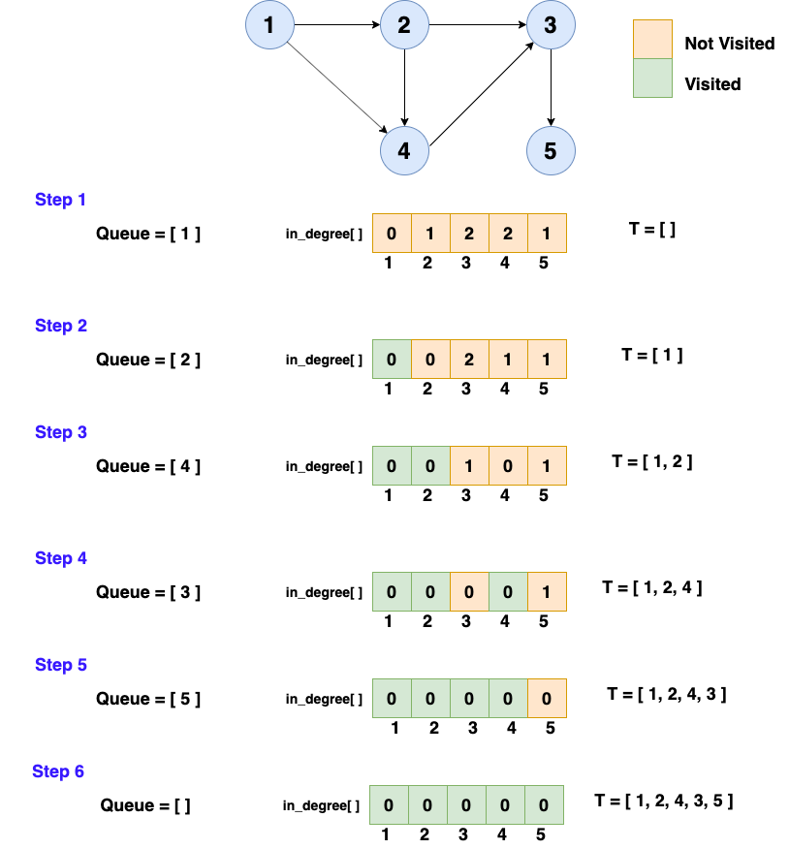
Topological Sort

Slide 20
Topological Sort
Applications
Scheduling jobs from given dependencies among Jobs. For example, if some job requires the dependency of some other job, then we can use topological sorting.
Instruction Scheduling
Determining the order of compilation tasks to perform in makefiles, data serializations and resolving symbol dependencies in linkers.
Use in maven dependency resolutions.

Slide 21
Thanking you !!!!
Any question !!!!!
Download PPT : https://github.com/sachin365123/Applies-Data-Structure-and-Application-GLA-Online-Sessions-Jan---Jun-2026

